Slide 1



UNIT 4
LESSON 15
Healthy and happy
Part 2

Slide 2
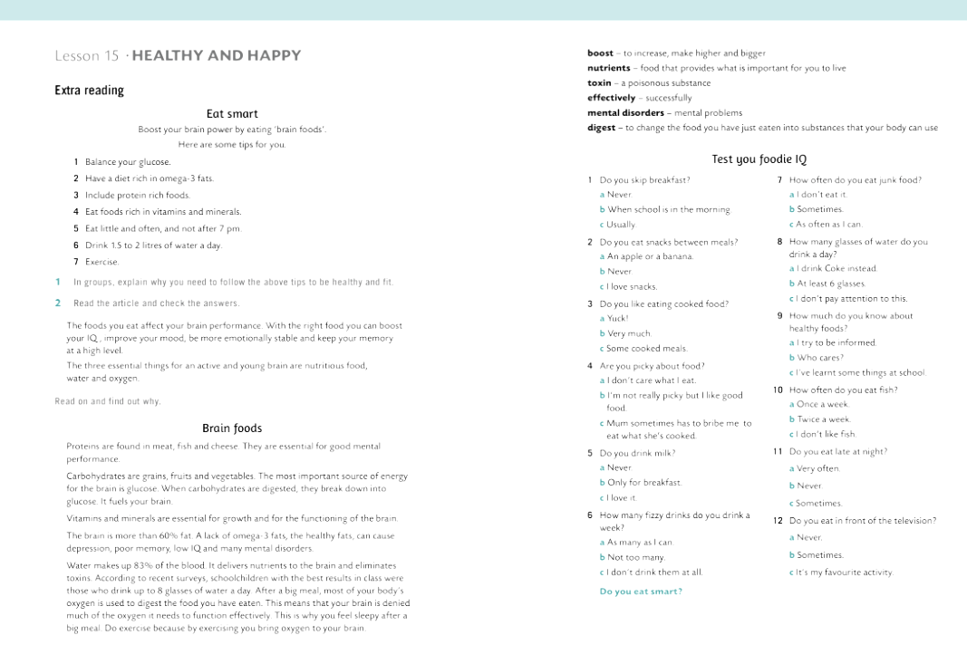
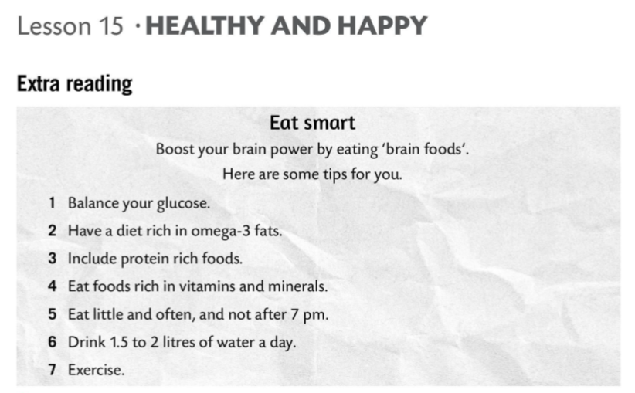
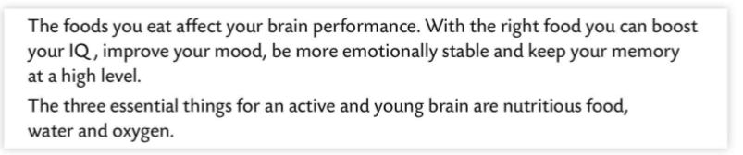
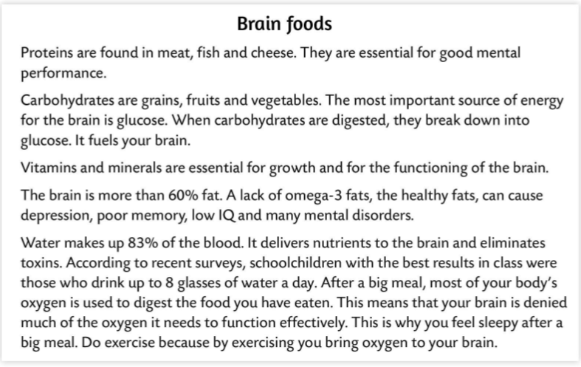
I didn’t know that...
I already knew that...
The most surprising thing is...
The most interesting piece of information...

Slide 3
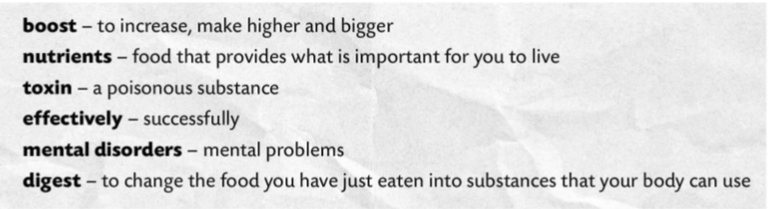
povećati
hranjive tvari
otrov
učinkovito
mentalni poremećaj
probaviti
6 Omega - 3 fats are healthy fats. T F
meat, fish, cheese
1 Proteins are found in grains, fruits and vegetables. T F
7 Omega – 3 fats improve your memory and IQ. T F
2 To be mentally fit you need to eat a lot of carbohydrates. T F
eight glasses of water
proteins
8 Children who drink a lot of water have better school results. T F
3 The most important source of energy for the brain is glucose. T F
9 Fat makes up 80% of the brain. T F
60%
4 Vitamins and minerals are vital for growth. T F
10 After a big meal, your brain gets less oxygen. T F
5 The brain is more than 60% water. T F
more than 83%

Slide 4
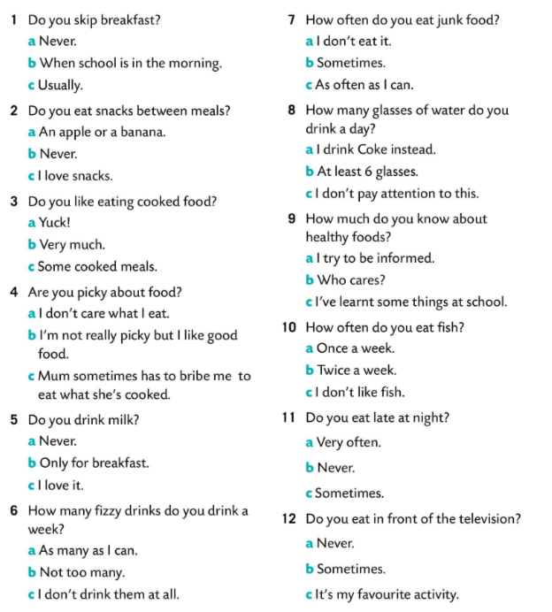


Slide 5
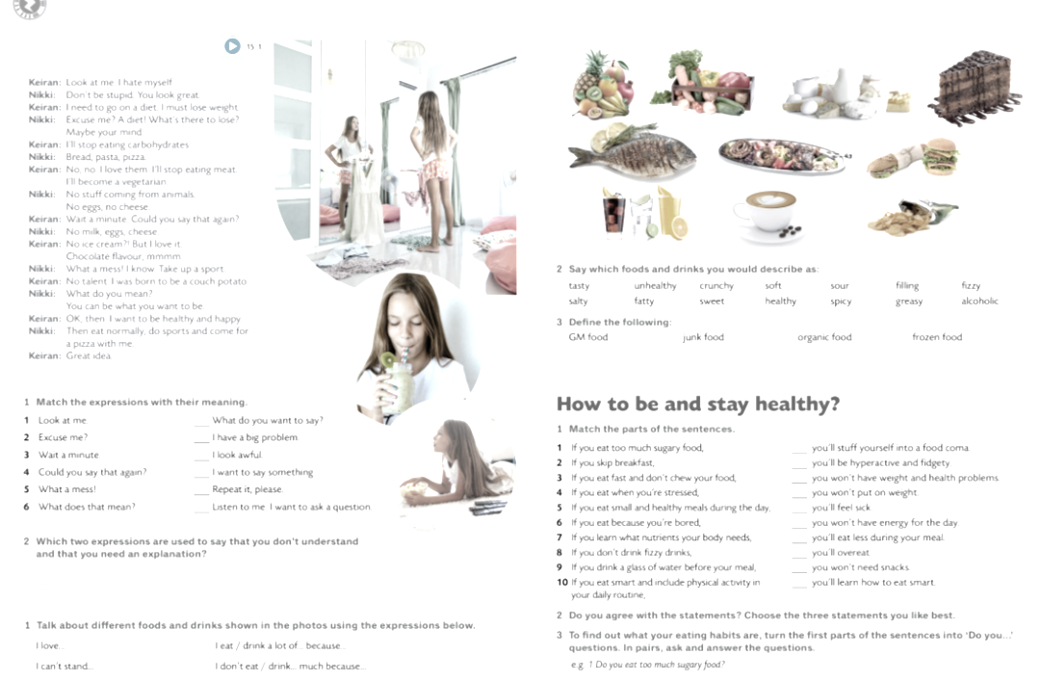

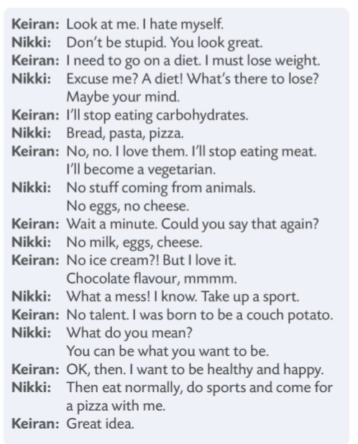

LOOK AT ME. I HATE MYSELF.
1 What is Keiran’s problem?
2 What does Keiran think she should do?
3 What suggestions does Nikki give her?

Slide 6

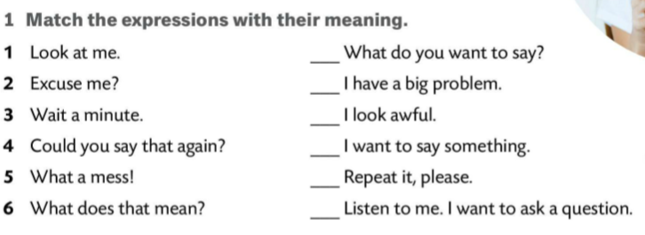


6
5
1
3
4
2
Excuse me?
What does that mean?

Slide 7
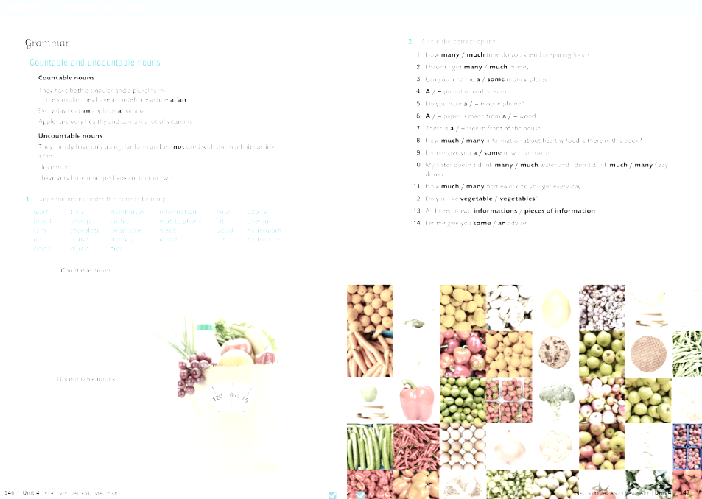
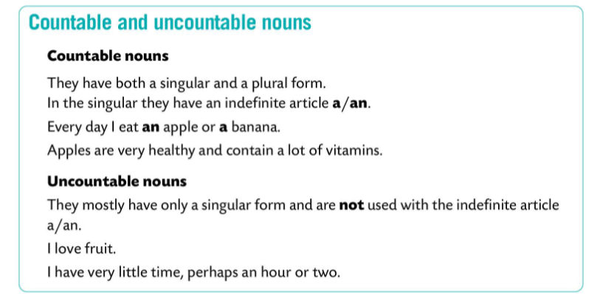
If Keiran decides to become a vegetarian, she will have to stop eating eggs and cheese.
EGGS
CHEESE
CAR
BREAD
HAMBURGER
COFFEE

Slide 8
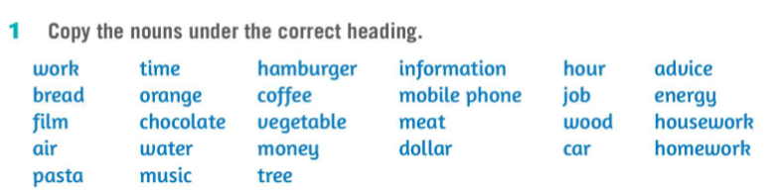
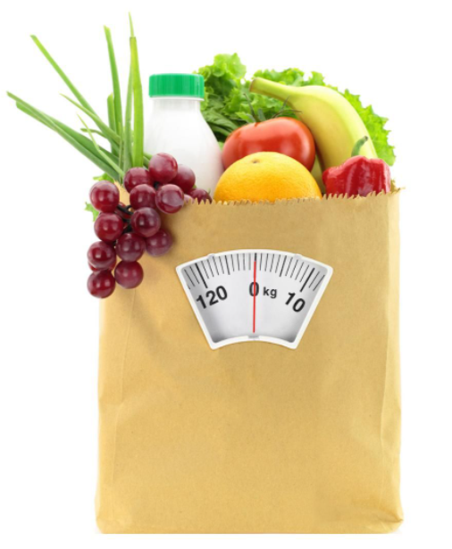
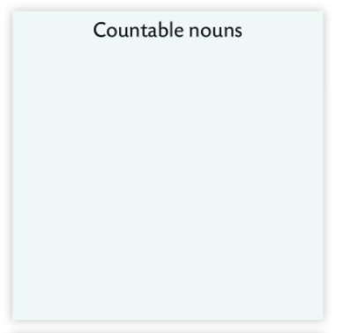
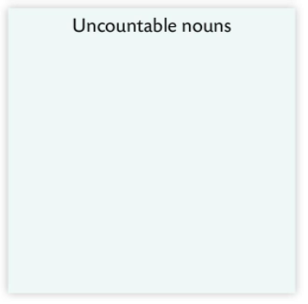
orange
work
air
pasta
film
vegetable
water
music
time
hamburger
meat
tree
coffee
money
mobile phone
dollar
information
wood
housework
job
energy
bread
hour
car
advice
homework
chocolate

Slide 9
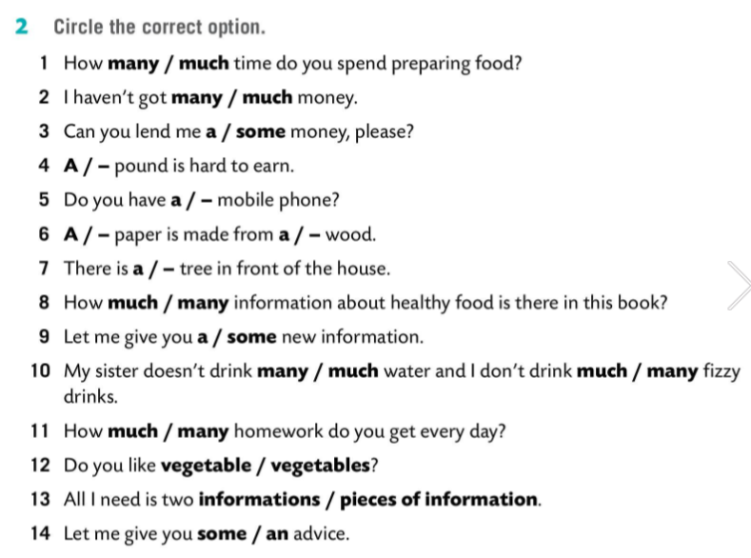


Slide 10
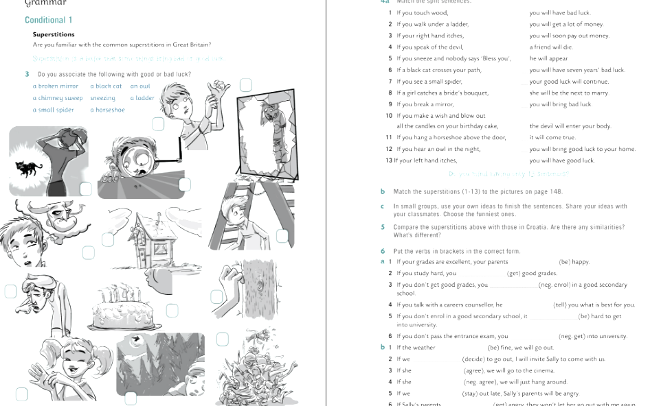
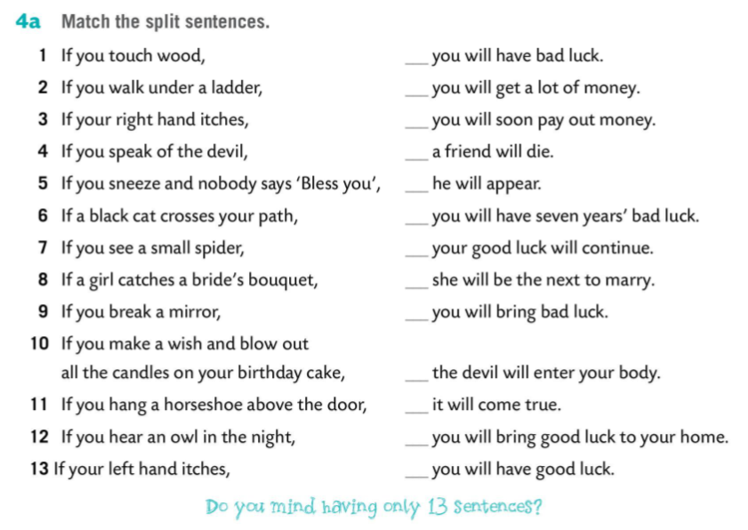
6
3
13
12
4
9
1
8
2
5
10
11
7

Slide 11
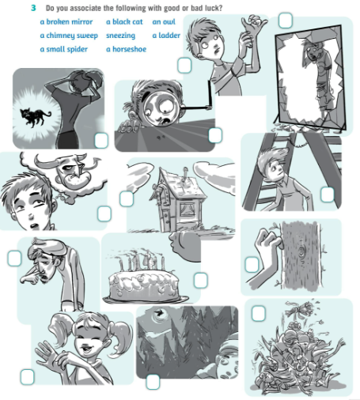
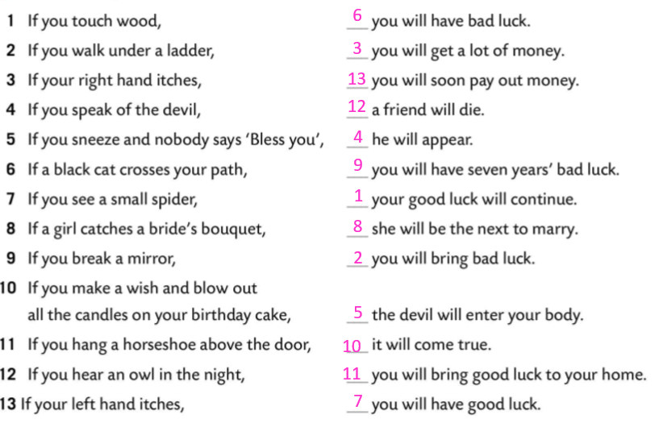
9
13
6
7
11
2
4
5
1
10
8
3
12

